Slide 1
Introducing Daily Gifted Math
Grades Three, Four, Five

Slide 2
Daily Gifted Math
1
2
3
Program
Criteria
Program
Goals
Daily
Details

Slide 3
Student Criteria
MAP
Student Criteria
These parts make up a scoring matrix. The student needs a combined score of 12 or better.
OLSAT
TR
Grades

Slide 4
Program Goals
2
What is the program trying to accomplish?

Slide 5
Our Goals are to increase critical thinking, problem solving, and student motivation !
Children will be taught their grade level skills from the Everyday Math Curriculum at a faster pace. Since less time will be spent on skill instruction, students will have the opportunity to complete more challenging work. Teachers will regularly evaluate students to see how much instruction a skill requires.

Slide 6
Grade 3 Grade 4 Grade 5 Awesome Algebra At the Mall with Algebra Using Algebra to Analyze Change Me in Measurement Getting into Shapes Exploring Fractions Everyday Math + Money Island+ Math Minute + Project M3 (Mentoring Mathematical Minds) + Integration of Technology + Collaborative Learning Activities = Daily Gifted Math Program
Materials that we will use to meet our goals!
We have curriculum samples available for you to look over!

Slide 7
In addition to the regular Math curriculum, what kind of activities will the children do?
Children will participate in small group, collaborative, problem solving activities.
Materials such as the Mentoring Mathematical Minds encourage a spirit of inquiry in the classroom. Students will listen to what their peers say and carefully considered all mathematical options to a real life problem.

Slide 8
Technology
*Money Island is an exciting online world that teaches kids about money through quests to exotic destinations. It uses interactive games, videos, and quizzes to teach financial skills.
*Students will use programs that present and organized newly acquired skills such as Excel and Power Point.
*Students will be encouraged to research, communicate, and practice Mathematical skills using technology.

Slide 9
Daily details
3
The “nuts and bolts” of the program!

Slide 10
Gifted Staff
Third Grade
Southwest School
Mrs. Kim Shine
708-424-2444 or
708-423-0950
Extension 2122
Fourth Grade
Southeast School
Mrs. Amanda Ewert
708-423-0950
Extension 2122
Fifth Grade
Northwest School
Mrs. Louise Baldwin
708-425-9473 or
708-423-0950
Extension 2122

Slide 11
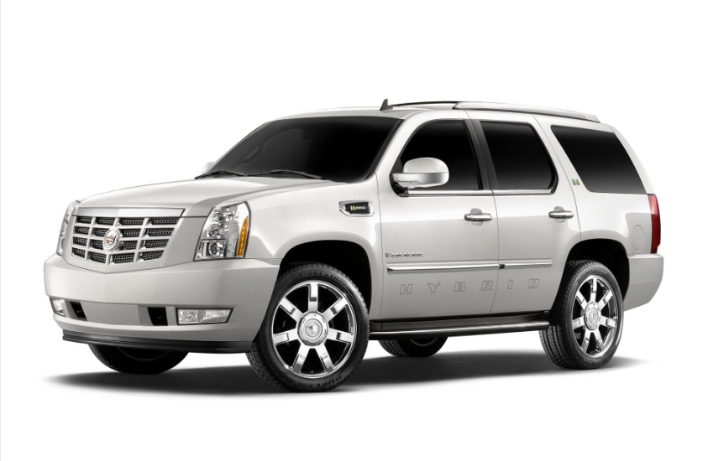
Transportation
Parents are responsible for getting their student to the math class in the morning.
Monday, Tuesday, Thursday, Friday:
Students enter at 8:20. Instruction begins at 8:30.
Late start Wednesdays: Students enter at 9:20. Instruction begins at 9:30.
There are 70 minutes of math instruction.
The school district is responsible for transporting the students to their home schools.
Student start date is still to be determined.

Slide 12
Pre-Assessment: What skills do the students already have?
Here are some of our pre- assessment methods:
Formal Pretests
Knowledge Inventory
KWL Charts
Interviews
Questioning (Oral & Written)
Anecdotal Records
Teacher Observation

Slide 13
Formative Assessments
Rubrics
Peer and Self Evaluation
Traditional Testing
Questioning Strategies
Conferencing
Teacher Observation
Portfolio
Anecdotal Records
MAP
AIMs
These are formative or ongoing assessments.

Slide 14
Summative evaluations
Exit Cards
Products
End of the Unit Test
Portfolio Reviews
Teacher Scored Rubrics
MAP
AIMs
What does the student know at the end of the unit?

Slide 15
Teacher
Family
Collaboration
Student
Success!
Administration
We need your support as we begin this new initiative. Your child may have more homework than before, please encourage him/her by providing a structured time & place for homework.
We created a website to keep you informed:
http://d124projecttree.weebly.com/index.html

